Slide 1

WS-011 Windows Server 2019 Administration

Slide 2
Module 11: Server and performance monitoring in Windows Server
Notes:
Presentation: 60 minutes
Lab: 60 minutes
After completing this module, students will be able to:
Describe the monitoring tools for the Windows Server.
Use the Performance Monitor tool to view and analyze performance statistics of programs that are running on their servers.
Monitor event logs to observe and interpret the recorded events.
Required materials
To teach this module, you need the Microsoft Office PowerPoint file WS-011T-11.pptx.
Important: We recommend that you use Office PowerPoint 2007 or a newer version to display the slides for this course. If you use PowerPoint Viewer or an older version of PowerPoint, all the features of the slides might not display correctly.
Preparation tasks
To prepare for this module:
Read all of the materials for this module.
Practice performing the demonstrations and the lab exercises.
Work through the Module Review and Takeaways section, and determine how you will use this section to reinforce student learning and promote knowledge transfer to on-the-job performance.

Slide 3
Module Overview
Overview of Windows Server monitoring tools Using Performance Monitor Monitoring event logs for troubleshooting

Slide 4
Lesson 1: Overview of Windows Server monitoring tools

Slide 5
Lesson 1: Overview
Overview of Task Manager Overview of Performance Monitor Overview of Resource Monitor Overview of Reliability Monitor Overview of Event Viewer Monitoring a server with Server Manager
Monitoring a server with Windows Admin Center
Using Sysinternals tools to monitor servers
Notes:
Provide an overview of the topics that you will discuss with students in this lesson.

Slide 6
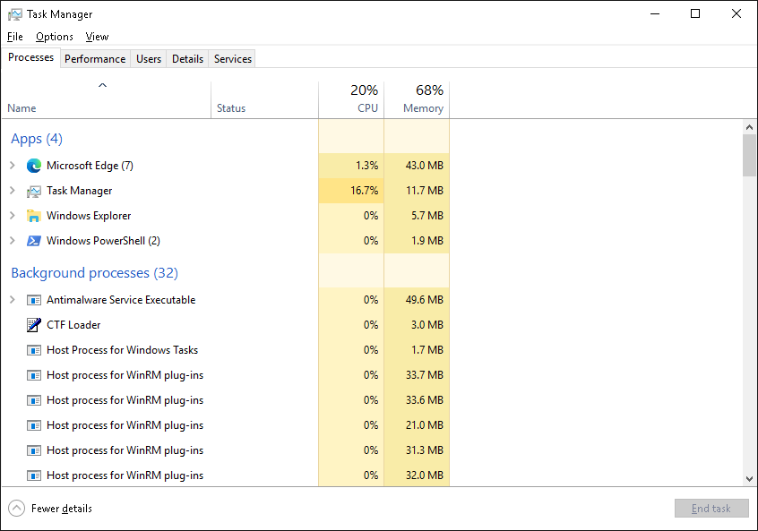
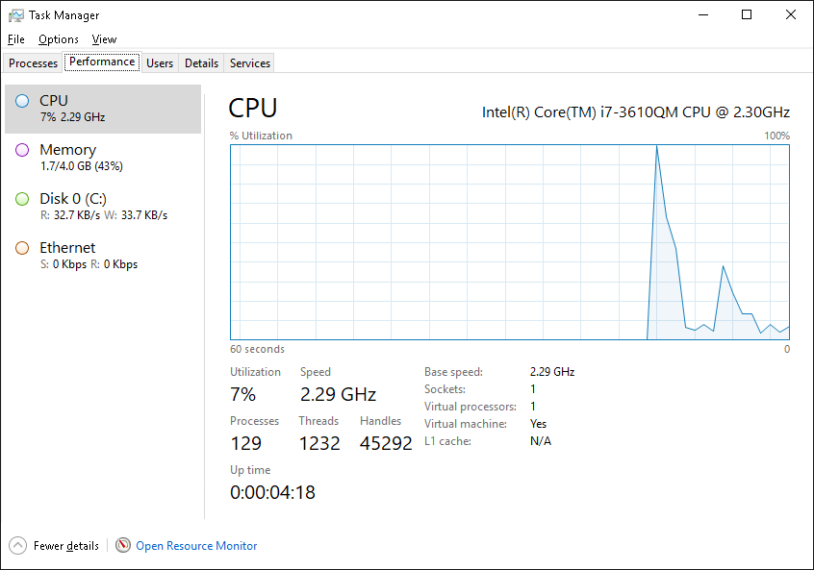
Overview of Task Manager
Task Manager helps you to identify and resolve performance-related issues
Notes:
Instructor notes
Consider demonstrating how to use Task Manager and its various tabs. Make sure you mention that although Task Manager can display performance-related data, it can only display a brief snapshot in time of the current activity.

Slide 7
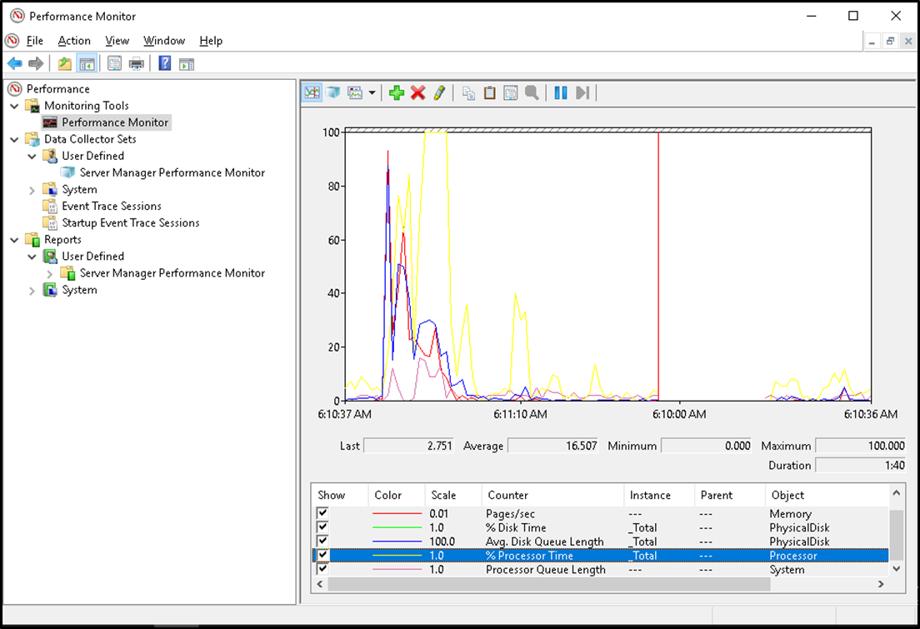
Overview of Performance Monitor (1 of 2)
Performance Monitor enables you to observe current performance statistics or to study historical data that Data Collector Sets have gathered
Notes:
Instructor notes
There are two slides. The first slide displays Performance Monitor, and the second slide displays common counters.
You can use Performance Monitor to examine how the programs that you run affect your server's performance, both in real time and by collecting log data for later analysis.
To access Performance Monitor, on the Performance Information and Tools page, select Advanced Tools.
You can monitor data through Performance Monitor by using:
Monitoring Tools
Data Collector Sets
Reports
Briefly mention that you can access Resource Monitor from Performance Monitor.
Inform students that during the process of installing other applications, such as Microsoft Exchange Server or Microsoft SQL Server data-management software, Windows Server adds application-specific Exchange Server and SQL Server performance counters to Performance Monitor.
Consider demonstrating the interface while discussing it with students.

Slide 8
Overview of Performance Monitor (2 of 2)
Primary processor counters:
Processor > % Processor Time
System > Processor Queue Length
Primary disk counters:
Physical Disk > % Disk Time
Physical Disk > Avg. Disk Queue Length
Primary network counters:
Network Interface > Output Queue Length
Network Interface > Bytes Total/sec
Primary memory counter:
The Memory > Pages/sec

Slide 9
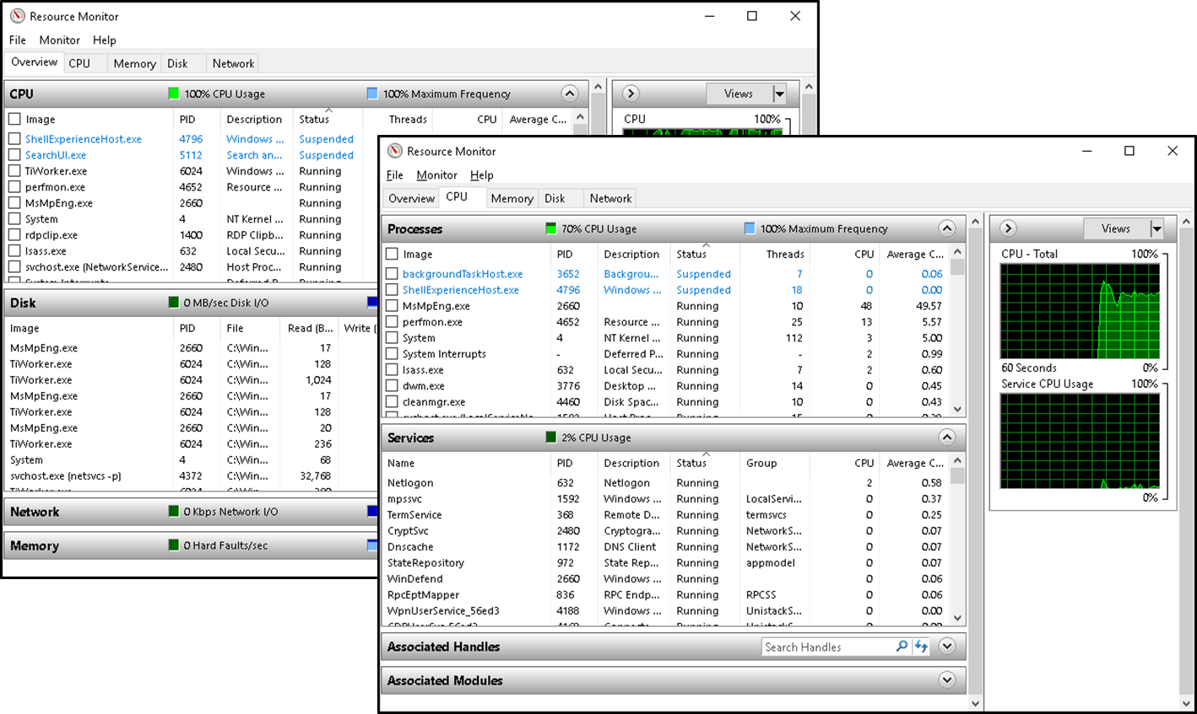
Overview of Resource Monitor
Resource Monitor provides an in-depth understanding at the real-time performance of your server
Notes:
Instructor notes
Explain how the Resource Monitor interface in Windows Server provides an in-depth overview of a server's real-time performance. Explain how students can use Resource Monitor to monitor the use and performance of CPU, disk, network, and memory resources in real time. Explain how it will enable them to identify and resolve resource conflicts and bottlenecks.
Consider demonstrating this tool while discussing it.

Slide 10
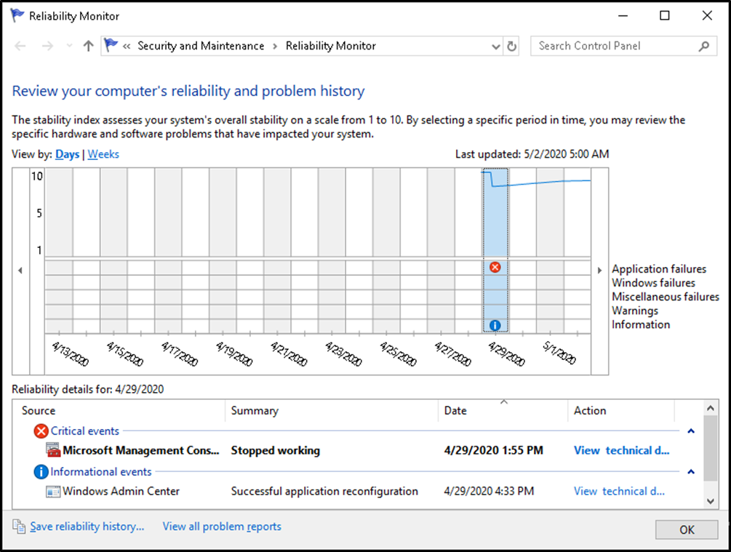
Overview of Reliability Monitor
Reliability Monitor monitors hardware and software issues that occur during the selected time interval and assigns a number called the stability index that indicates the server’s reliability
Notes:
Instructor notes
Explain how Reliability Monitor works and demonstrate using it to explain the information that it makes available. Use the following information:
Monitors hardware and software issues
Provides a stability index number from 1 to 10:
1 represents the lowest stability
10 represents the highest stability
Reliability Monitor window components include:
Historical reports on the stability index
Reliability details
Action to perform, such as saving historical data, starting the Problem Reports console, and checking online for a solution to a specific problem.

Slide 11
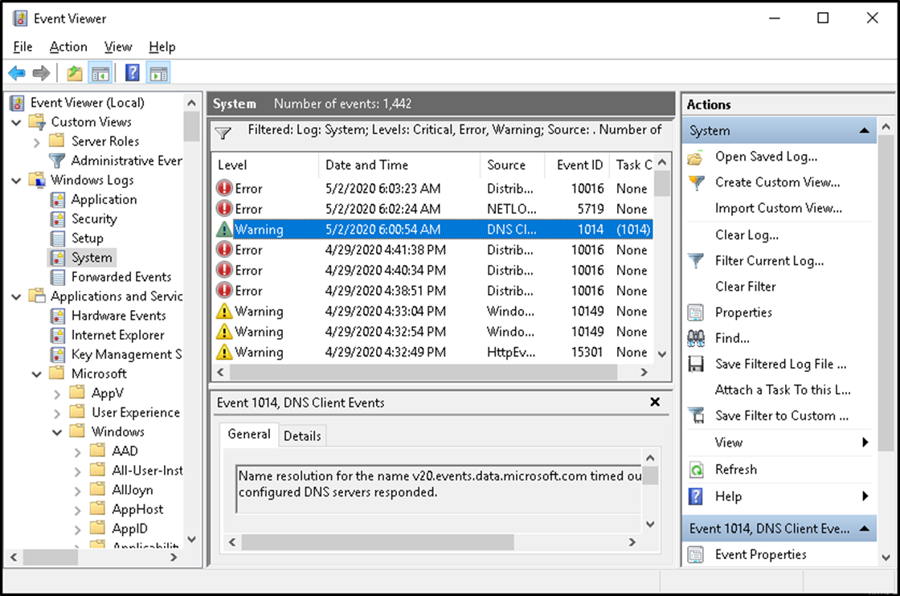
Overview of Event Viewer
Event Viewer provides categorized lists of essential Windows log events and log groupings for individual installed applications and specific Windows component categories
Notes:
Instructor notes
Most students should be familiar with the basics of Event Viewer. Consider demonstrating the Applications and Services Logs node.

Slide 12
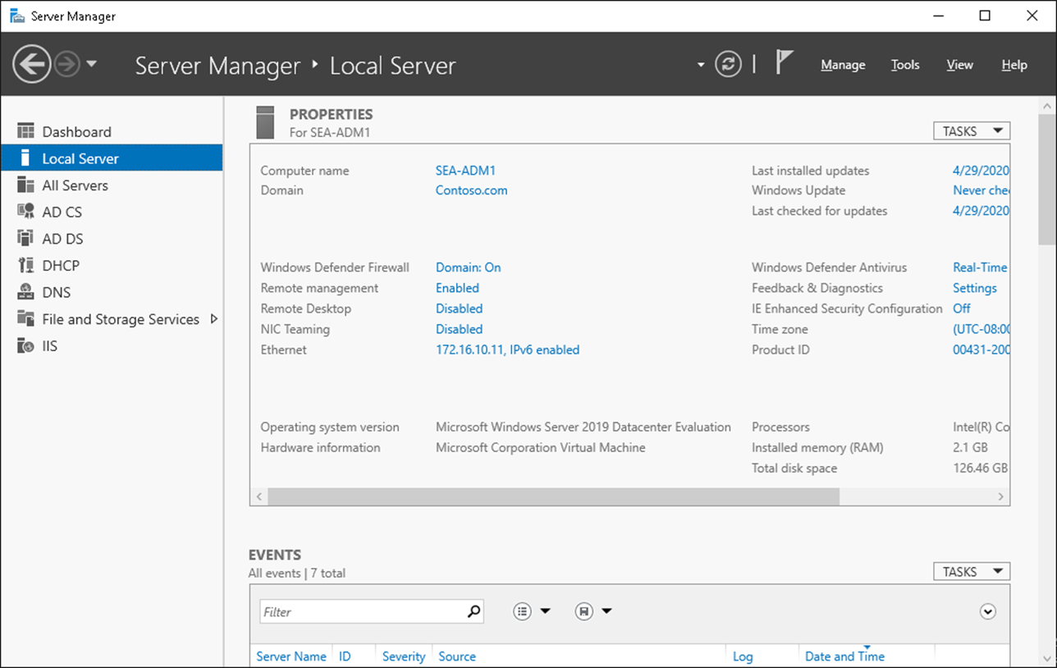
Monitoring a server with Server Manager
Notes:
Instructor notes
Explain to students the scenarios in which they can use Server Manager to monitor servers that are running the Windows operating system. Additionally, introduce the Server Manager console to students and demonstrate several ways to monitor information from the console.

Slide 13
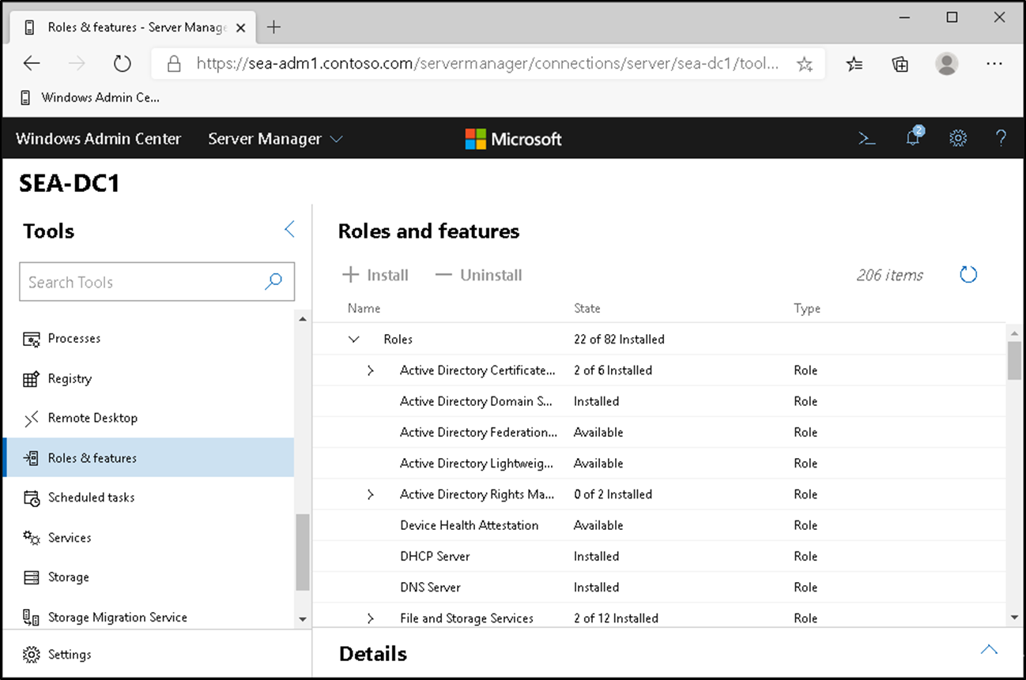
Monitoring a server with Windows Admin Center
Notes:
Instructor notes
Most students will be unfamiliar with using Windows Admin Center. Demonstrate the basic features. Start SEA-DC1 and SEA-ADM1. On SEA-ADM1, open Microsoft Edge, and then select the Windows Admin Center link. Sign in and then demonstrate the key features.
Consider using Windows Admin Center to demonstrate the System Insights feature in Windows Server.

Slide 14
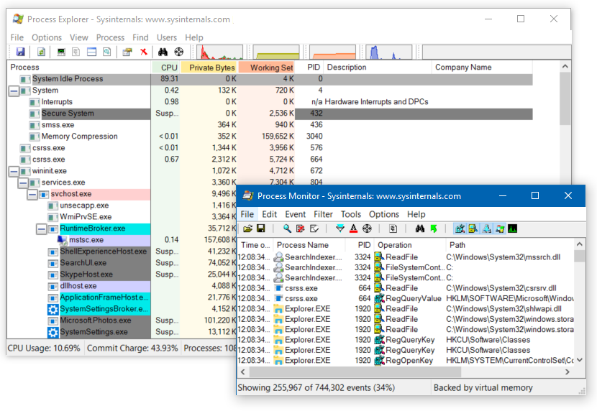
Using Windows Sysinternals tools to monitor servers
Notes:
Instructor notes
Consider downloading, installing, and demonstrating these tools to your students.

Slide 15
Lesson 1: Test your knowledge
Refer to the Student Guide for lesson review questions

Slide 16
Lesson 2: Using Performance Monitor

Slide 17
Lesson 2: Overview
Overview of baselines, trends, and capacity planning What are data collector sets? Demonstration: Capture counter data with a data collector set Demonstration: Configure an alert Demonstration: View reports in Performance Monitor Monitoring network infrastructure services Considerations for monitoring virtual machines
Performance monitoring with Windows Admin Center
Notes:
Provide an overview of the topics that you will discuss in this lesson.

Slide 18
Overview of baselines, trends, and capacity planning
By calculating performance baselines for your server environment, you can more accurately interpret real-time monitoring information
By establishing a baseline, you can:
Interpret performance trends
Perform capacity planning
Identify bottlenecks
Analyze performance trends to predict when existing capacity is likely to be exhausted
Plan the capacity for the key hardware components such as processor, disk, memory, and network
Notes:
Instructor notes
Ask students if they have experience using data-gathering tools to establish a performance baseline. Remind them that the baseline should include certain core components. The four main hardware components to monitor in any Windows Server installation are processor, disk, memory, and network.
Tell students that by learning how the operating system uses these four key hardware components and how they interact with one another, they can learn how to optimize server performance.
When monitoring performance, consider:
The measurement of all key server components.
The server role and workload to determine which hardware components are likely to restrict performance.
The ability to increase server performance by adding power or by reducing the number of applications that a user is running.

Slide 19
What are data collector sets?
Data collector sets enable you to gather performance-related and other system statistics for analysis
Data collector sets can contain the following types of data collectors:
Performance counters
Event trace data
System configuration information
Notes:
Instructor notes
Describe data collector sets. In the next topic, you'll demonstrate them.

Slide 20
Demonstration: Capture counter data with a data collector set
Create a data collector set
Create a disk load on the server
Analyze the resulting data in a report
Notes:
Leave the virtual machines (VMs) running for subsequent demonstrations.
Preparation steps
You require the WS-011T00A-SEA-DC1, WS-011T00A-SEA-ADM1, and WS-011T00A-SEA-CL1 VMs for this demonstration.
Demonstration steps
Create a data collector set
Switch to SEA-ADM1.
Sign in as Contoso\Administrator with the password Pa55w.rd.
Select Start, and then enter Perf in the search box.
In the Apps list, select Performance Monitor.
In Performance Monitor, expand Data Collector Sets in the navigation pane, and then select User Defined.
Right-click or access the context menu for User Defined, select New, and then select Data Collector Set.
In the Create New Data Collector Set Wizard, enter SEA-ADM1 Performance in the Name box.
Select Create manually (Advanced), and then select Next.
On the What type of data do you want to include? page, select the Performance counter check box, and then select Next.
On the Which performance counters would you like to log? page, select Add.
In the Available counters list, expand Processor, select % Processor Time, and then select Add.
In the Available counters list, expand Memory, select Pages/sec, and then select Add.
In the Available counters list, expand PhysicalDisk, select % Disk Time, and then select Add.
Select Avg. Disk Queue Length, and then select Add.
In the Available counters list, expand System, select Processor Queue Length, and then select Add.

Slide 21
Demonstration: Capture counter data with a data collector set (2 of 3)
Notes:
In the Available counters list, expand Network Interface, select Bytes Total/sec, select Add, and then select OK.
On the Which performance counters would you like to log? page, in the Sample interval box, enter 1, and then select Next.
On the Where would you like the data to be saved? page, select Next.
On the Create the data collector set? page, select Save and close, and then select Finish.
In Performance Monitor, in the results pane, right-click or access the context menu for SEA-ADM1 Performance, and then select Start.
Create a disk load on the server
On the taskbar, select the Windows PowerShell icon.
At the Windows PowerShell command prompt, enter the following command, and then select Enter: -Fsutil file createnew bigfile 104857600
At the command prompt, enter the following command, and then select Enter:
Copy bigfile \SEA-dc1\c$
At the command prompt, enter the following command, and then select Enter: -Copy \SEA-dc1\c$\bigfile bigfile2
At the command prompt, enter the following command, and then select Enter: -Del bigfile.*
At the command prompt, enter the following command, and then select Enter: -Del \SEA-dc1\c$\bigfile*.*
Close the Command Prompt window.
Analyze the resulting data in a report
Switch to Performance Monitor.
In the navigation pane, right-click or access the context menu for SEA-ADM1 Performance, and then select Stop.
In Performance Monitor, select Performance Monitor in the navigation pane.
On the toolbar, select the View log data icon.

Slide 22
Demonstration: Capture counter data with a data collector set (3 of 3)
Notes:
In the Performance Monitor Properties dialog box, select Log files on the Source tab, and then select Add.
In the Select Log File dialog box, double-click or select Admin, and then select Enter.
Double-click or select SEA-ADM1 Performance and then select Enter, double-click or select the SEA-ADM1_date-000001 folder and then select Enter, and then double-click or select DataCollector01.blg and then select Enter.
Select the Data tab, and then select Add.
In the Add Counters dialog box, in the Available counters list, expand Memory, select Pages/sec, and then select Add.
Expand Network Interface, select Bytes Total/sec, and then select Add.
Expand PhysicalDisk, select %Disk Time, and then select Add.
Select Avg. Disk Queue Length, and then select Add.
Expand Processor, select %Processor Time, and then select Add.
Expand System, select Processor Queue Length, select Add, and then select OK.
In the Performance Monitor Properties dialog box, select OK.
On the toolbar, on the Change graph type icon, select the down arrow, and then select Report.

Slide 23
Demonstration: Configure an alert
Create a data collector set with an alert counter
Generate a server load that exceeds the configured threshold
Examine the event log for the resulting event
Notes:
Leave the virtual machines (VMs) running for subsequent demonstrations.
Preparation steps
The required VMs, WS-011T00A-SEA-DC1, WS-011T00A-SEA-ADM1, and WS-011T00A-SEA-CL1, should be running after the preceding demonstration.
Demonstration steps
Create a data collector set with an alert counter
On SEA-ADM1, in Performance Monitor, expand Data Collector Sets in the navigation pane, and then select User Defined.
Right-click or access the context menu for User Defined, select New, and then select Data Collector Set.
In Create New Data Collector Set Wizard, enter SEA-ADM1 Alert in the Name box.
Select Create manually (Advanced), and then select Next.
On the What type of data do you want to include? page, select Performance Counter Alert, and then select Next.
On the Which performance counters would you like to monitor? page, select Add.
In the Available counters list, expand Processor, select %Processor Time, select Add, and then select OK.
On the Which performance counters would you like to monitor? page, in the Alert when list, select Above.
In the Limit box, enter 10, and then select Next.
On the Create the data collector set? page, select Finish.
In the navigation pane, expand the User Defined node, and then select SEA-ADM1 Alert.
In the results pane, right-click or access the context menu for DataCollector01, and then select Properties.
In the DataCollector01 Properties dialog box, in the Sample interval box, enter 1, and then select the Alert Action tab.
Select the Log an entry in the application event log check box, and then select OK.
In the navigation pane, right-click or access the context menu for SEA-ADM1 Alert, and then select Start.

Slide 24
Demonstration: Configure an alert (2 of 2)
Notes:
Generate a server load that exceeds the configured threshold
Open File Explorer, and then browse to C:\Labfiles\Mod11.
Double-click or select CPUSTRES64.EXE, and then select Enter.
In the CPU Stress - Sysinternals:www.sysinternals.com dialog box, right-click or access the context menu for the highlighted thread at the top of the list of running threads, select Activity Level, and then select Busy (75%).
Wait a minute to allow alert generation.
Press Ctrl+C.
Close CPUSTRES64 and File Explorer.
Examine the event log for the resulting event
Select Start, enter Event on the Start page, and then in the Apps list, select Event Viewer.
In Event Viewer, expand Applications and Services Logs in the navigation pane, expand Microsoft, expand Windows, expand Diagnosis-PLA, and then select Operational.
Examine the log for performance-related messages. These have an Event ID of 2031. Leave Event Viewer running.

Slide 25
Demonstration: View reports in Performance Monitor
View a performance report
Notes:
Preparation steps
The required virtual machines, WS-011T00A-SEA-DC1, WS-011T00A-SEA-ADM1, and WS-011T00A-SEA-CL1, should be running after the preceding demonstration.
Demonstration steps
View a performance report
On SEA-ADM1, in Performance Monitor, in the navigation pane, expand Reports, expand User Defined, and then select SEA-ADM1 Performance.
Expand the folder next to SEA-ADM1 Performance. The data collector set's previous collection process generated this report. You can change from the chart view to any other supported view.
If the report isn't displaying, select Refresh on the toolbar, and then repeat step 2.
Close all open windows.

Slide 26
Monitoring network infrastructure services
Monitoring is essential for:
Optimizing network infrastructure server performance
Troubleshooting servers
Common services to monitor:
DNS
DHCP
Notes:
Instructor notes
Describe how to monitor a network, and then tell students that to have a healthy and reliable IT environment, they should not only monitor server components, but also networking components.
Provide the following examples:
Poor Domain Name System (DNS) performance will affect many critical services such as Active Directory Domain Services (AD DS), internet access, and other applications that depend on AD DS such as Microsoft Exchange Server, Microsoft SQL Server data-management software, and Microsoft SharePoint Server.
If Dynamic Host Configuration Protocol (DHCP) is performing poorly, clients can't obtain IP addresses. This results in limited network connectivity.

Slide 27
Considerations for monitoring virtual machines
Considerations for monitoring virtual machines:
Virtual machines must be assigned sufficient resources for their workload
If multiple virtual machines run on a host, ensure the host has enough resources
Resources are shared, so performance of one virtual machine can affect the performance of others
You must remember to monitor the resource utilization on the host as well as the guests
Notes:
Instructor notes
Emphasize to students that monitoring virtual machines (VMs) is no different from monitoring host-based servers, and that they can use the same tools and techniques. However, also mention that they can use Hyper-V Resource Metering specifically for VM monitoring.

Slide 28
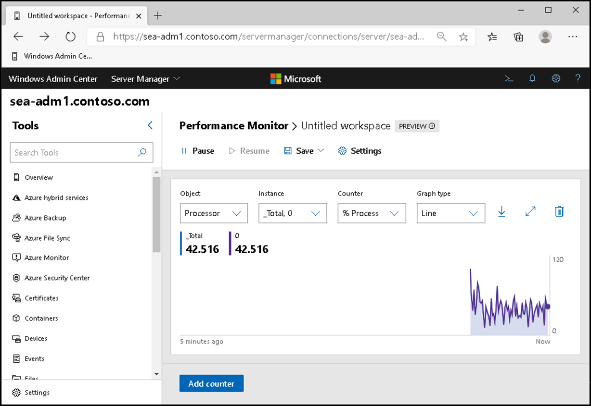
Performance monitoring with Windows Admin Center
Notes:
Instructor notes
Students might be unfamiliar with using Windows Admin Center. Consider demonstrating its use by using the SEA-ADM1 virtual machine.

Slide 29
Lesson 2: Test your knowledge
Refer to the Student Guide for lesson review questions

Slide 30
Lesson 3: Monitoring event logs for troubleshooting

Slide 31
Lesson 3: Overview
Using Server Manager to observe event logs What is a custom view? Demonstration: Create a custom view What are event subscriptions? Demonstration: Configure an event subscription
Notes:
Provide an overview of the topics that the lesson will discuss.

Slide 32
Using Server Manager to review event logs
Server Manager provides a centralized location for event logs from remote servers
Event logging
Enabled by default
Categorized by technology: AD DS, DNS, Remote Access
Customized views
Create queries for specific types of events that need to be displayed
Configure event data that needs to be displayed
Notes:
Instructor notes
Consider demonstrating using Server Manager to review remote events.
Explain to students the scenarios in which you'd use Server Manager for viewing event logs from different remote Windows servers. Also, display the Server Manager console for the students and demonstrate how you can monitor event log information from the console.

Slide 33
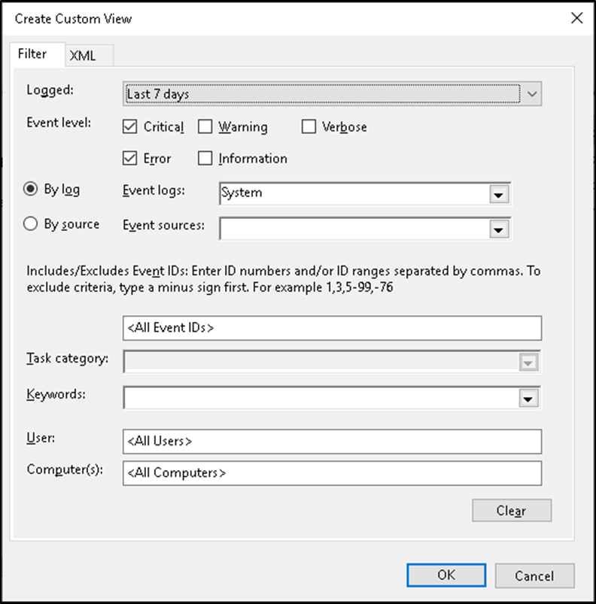
What is a custom view?
Custom views allow you to query and sort just the events that you want to analyze
Notes:
Instructor notes
Remind students that event logs contain vast amounts of data, and it could be challenging to narrow the set of events to just those of interest.

Slide 34
Demonstration: Create a custom view
Examine Server Roles custom views
Create a custom view
Notes:
Leave the virtual machines (VMs) running for subsequent demonstrations.
Preparation steps
The required virtual machines, WS-011T00A-SEA-DC1, WS-011T00A-SEA-ADM1, and WS-011T00A-SEA-CL1 should be running after the preceding demonstration.
Demonstration steps
Observe server roles custom views
On SEA-ADM1, open Event Viewer.
In the navigation pane, expand Custom Views, expand Server Roles, and then select Web Server (IIS). This is the web server role–specific custom view.
Create a custom view
In the navigation pane, right-click or access the context menu for Custom Views, and then select Create Custom View.
In the Create Custom View dialog box, select the Critical, Warning, and Error check boxes.
In the Create Custom View dialog box, expand Windows Logs in the Event logs drop-down list, select the System and Application check boxes, and then select OK.
In the Save Filter to Custom View dialog box, enter Contoso Custom View in the Name box, and then select OK.
In Event Viewer, observe the events that are visible within your custom view in the right pane.

Slide 35
What are event log subscriptions?
Event log subscriptions allow you to collect event logs from multiple servers, and then store them locally
Notes:
Instructor notes
Explain to students that Event Viewer includes the ability to collect copies of events from multiple remote computers and then store them locally. To specify which events to collect, create an event subscription. Among other details, the subscription specifies exactly which events will be collected and in which log they will be stored locally. After a subscription is active and events start collecting, students can review and manipulate these forwarded events just like any other locally stored events. Explain that before they can create a subscription to collect events on a computer, they must configure the collecting computer (the collector) and each computer from which events will be collected (the source).

Slide 36
Demonstration: Configure an event subscription
Configure the source computer
Configure the collector computer
Create and refer to the subscribed log
Notes:
Preparation steps
The required virtual machines, WS-011T00A-SEA-DC1, WS-011T00A-SEA-ADM1, and WS-011T00A-SEA-CL1 should be running after the preceding demonstration.
Demonstration steps
Configure the source computer
Switch to SEA-ADM1.
Sign in as Contoso\Administrator with the password Pa55w.rd.
Select Start, and then enter Cmd in the search box.
In the Apps list, select Command Prompt.
Enter the following command at the command prompt, and then select Enter:
winrm quickconfig
Note: The service is already running.
On the taskbar, select Server Manager.
In Server Manager, select Tools on the toolbar, and then select Computer Management.
In Computer Management (Local), expand System Tools, expand Local Users and Groups, and then select Groups.
In the results pane, double-click or select Event Log Readers, and then select Enter.
Select Add, and then select Object Types in the Select Users, Computers, Service Accounts or Groups dialog box.
In the Object Types dialog box, select the Computers check box, and then select OK.
In the Select Users, Computers, Service Accounts or Groups dialog box, enter SEA-CL1 in the Enter the object names to select box, and then select OK.
In the Event Log Readers Properties dialog box, select OK.

Slide 37
Demonstration: Configure an event subscription (2 of 2)
Notes:
Configure the collector computer
Switch to SEA-CL1.
Select Start, and then enter Cmd in the search box.
In the Apps list, select Command Prompt.
At the command prompt, enter the following command, and then select Enter:
Wecutil qc
When prompted, enter Y, and then select Enter.
Create and review the subscribed log
In Event Viewer, select Subscriptions in the navigation pane.
Right-click or access the context menu for Subscriptions, and then select Create Subscription.
In the Subscription Properties dialog box, enter SEA-ADM1 Events in the Subscription name box.
Select Collector Initiated, and then select Select Computers.
In the Computers dialog box, select Add Domain Computers.
In the Select Computer dialog box, enter SEA-ADM1 in the Enter the object name to select box, and then select OK.
In the Computers dialog box, select OK.
In the Subscription Properties – SEA-ADM1 Events dialog box, select Select Events.
In the Query Filter dialog box, select the Critical, Warning, Information, Verbose, and Error check boxes.
In the Logged drop-down list, select Last 30 days.
In the Event logs drop-down list, select Windows Logs, and then in the Query Filter dialog box, select OK.
In the Subscription Properties – SEA-DC1 Events dialog box, select OK.
In Event Viewer, expand Windows Logs in the navigation pane, and then select Forwarded Events.
Examine any listed events.

Slide 38
Lesson 3: Test your knowledge
Refer to the Student Guide for lesson review questions

Slide 39
Instructor-led lab: Monitoring and troubleshooting Windows Server
Establishing a performance baseline
Identifying the source of a performance problem
Configuring centralized event logs

Slide 40
Lab: Monitoring and troubleshooting Windows Server
Exercise 1: Establishing a performance baseline Exercise 2: Identifying the source of a performance problem Exercise 3: Viewing and configuring centralized event logs
Sign-in information for the exercise(s):
Virtual Machines:
WS-011T00A-SEA-DC1
WS-011T00A-SEA-ADM1
WS-011T00A-SEA-CL1
User Name: Contoso\Administrator
Password: Pa55w.rd
Notes:
Estimated Time: 60 minutes
Exercise 1: Establishing a performance baseline
In this exercise, you will use Performance Monitor on the server and create a baseline by using typical performance counters.
Exercise 2: Identifying the source of a performance problem
In this exercise, you will simulate a load to represent the system in live usage, gather performance data by using your data collector set, and then determine the potential cause of the performance problem.
Exercise 3: Viewing and configuring centralized event logs
In this exercise, you will use SEA-CL1 to collect event logs from SEA-ADM1. Specifically, you will use this process to gather performance-related alerts from your network servers.

Slide 41
Lab scenario
Contoso, Ltd is a global engineering and manufacturing company with its head office in Seattle, USA. An IT office and data center are in Seattle to support the Seattle location and other locations. Contoso recently deployed a Windows Server 2019 server and client infrastructure.
Because the organization has deployed new servers, it is important to establish a performance baseline with a typical load for these new servers. You have been asked to work on this project. Additionally, to make the process of monitoring and troubleshooting easier, you decide to perform centralized monitoring of event logs.

Slide 42
Lab review
During the lab, you collected data in a data collector set. What is the advantage of collecting data in this way?

Slide 43
Module review questions
What significant counters should you monitor in Performance Monitor?
Why is it important to monitor server performance periodically?
Why should you use performance alerts?

Slide 44
Module review answers
What significant counters should you monitor in Performance Monitor?
Answer: You should monitor the following: Processor > % Processor Time, System > Processor Queue Length, Memory > Pages/sec, Physical Disk > % Disk Time, and Physical Disk > Avg. Disk Queue Length
Why is it important to monitor server performance periodically?
Answer: By monitoring server performance, you can perform capacity planning, identify and remove performance bottlenecks, and assist with server troubleshooting.
Why should you use performance alerts?
Answer: By using alerts, you can react more quickly to emerging performance-related problems, perhaps before they have a chance to impinge on users’ productivity.

Slide 45
Thank you.

